Slide 1
Green Ammonia Plant Optimization Model Update and Downstream Development
6/5 Week

Slide 2
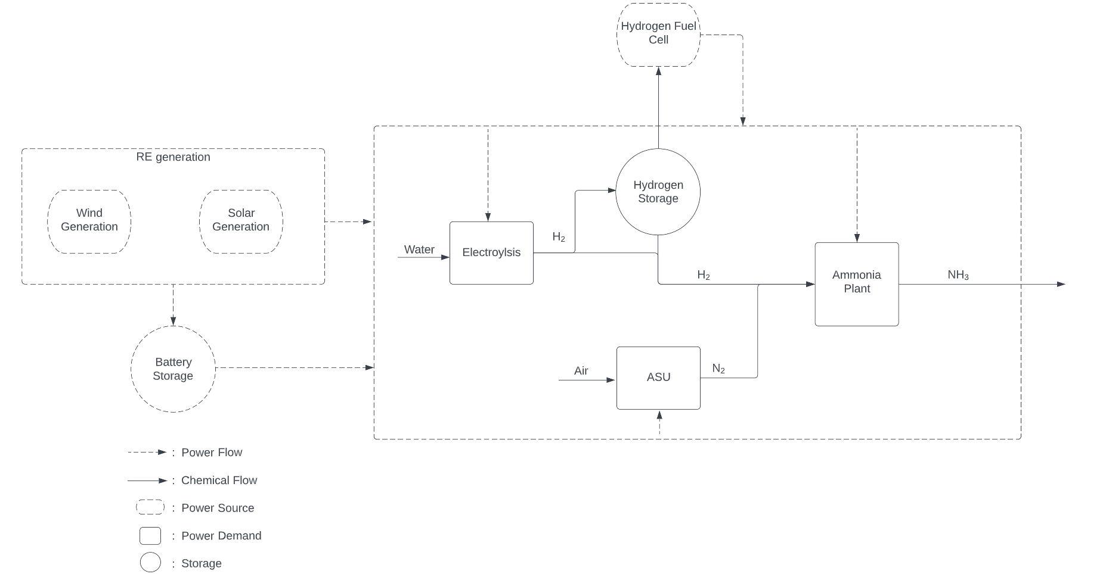
Updated model with fuel cell addition-does not change results. Waiting for data from the renewable energy atlas for more detailed runs

Slide 3
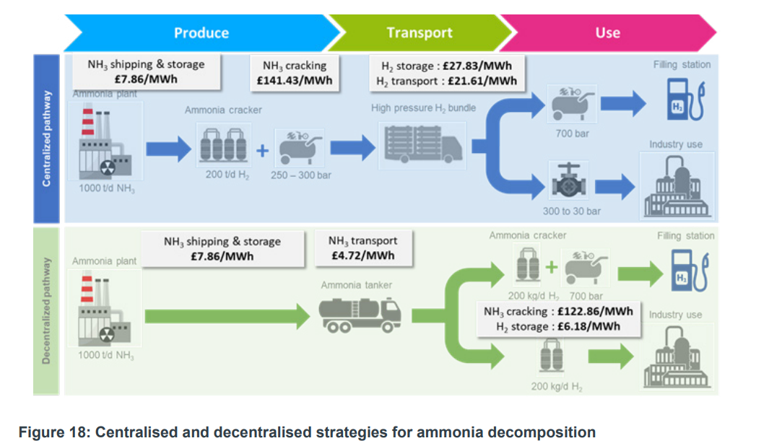
Goal of project: Providing a robust cost analysis of Green Ammonia Production- Therefore working on downstream side of supply chain (DLCOA)
Source HS420_-_Ecuity_-_Ammonia_to_Green_Hydrogen.pdf (publishing.service.gov.uk)

Slide 4
Model Structure includes dynamic production output and then dynamic demand for Ammonia/Hydrogen
Ammonia Plant Optimization (PLCOA)
Supply Chain Optimization
DLCOA & DLCOH
PLCOA: Production Levelized Cost of Ammonia
DLCOA: Delivered Levelized Cost of Ammonia
DLCOH: Delivered Levelized Cost of Hydrogen

Slide 5
Example walkthrough of supply chain optimization in import country

Slide 6
Model inputs: import region and demand locations
Import Region (UK, Germany, Japan, etc..)
Import Terminals (scaled by capacity)
H2 Demand Locations (scaled by demand)
*Hydrogen demand is the focus however can also include ammonia demand locations (no cracking needed)

Slide 7
Model then decides connections between cities and terminals: decentralized crack on site
Import Region
Cracked on site
NH3 Pipeline

Slide 8
Model also decides centralized cracking locations and the subsequent transport
Import Region
H2 transportation
Cracked off site (decentralized)
Cracked on site
NH3 Pipeline

Slide 9
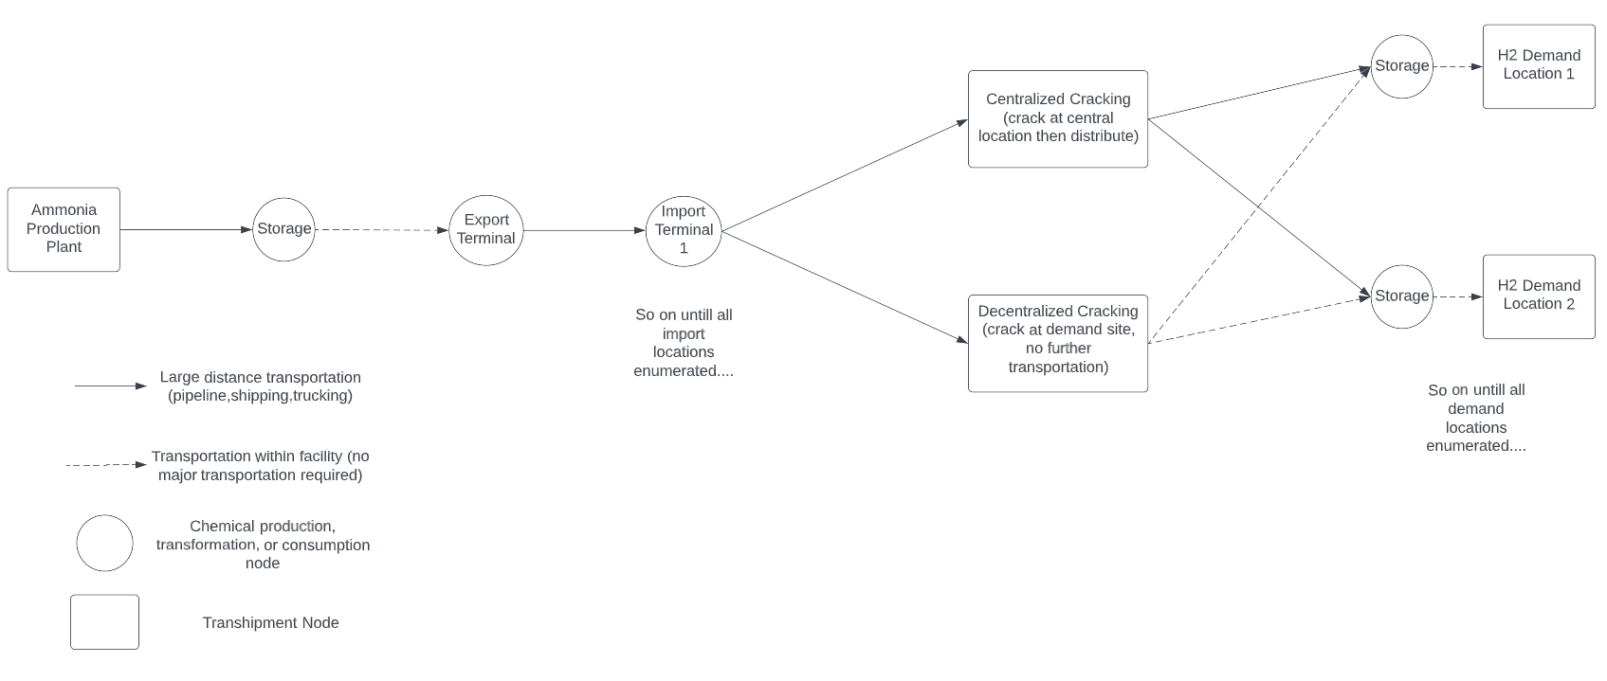
Creating downstream green ammonia supply chain: selecting centralized vs decentralized cracking option

Slide 10
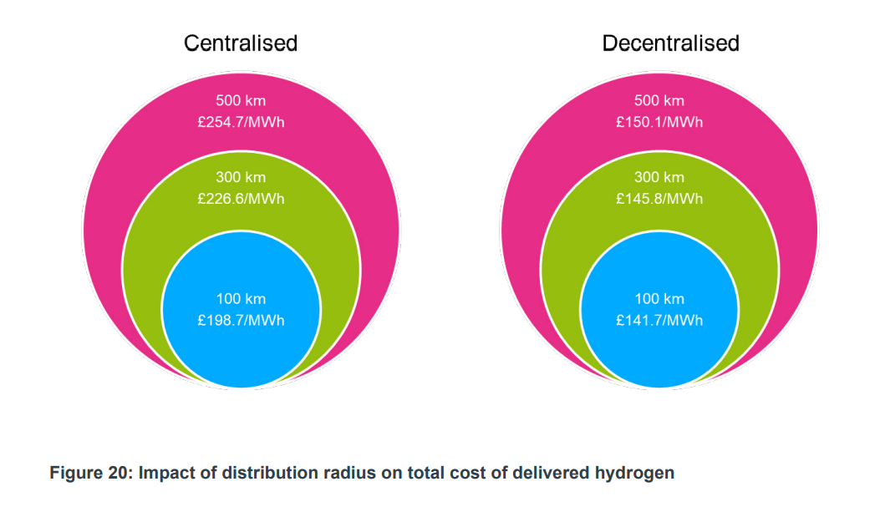
We know the radius from import terminal to demand location will decide centralized vs decentralized cracking
Source HS420_-_Ecuity_-_Ammonia_to_Green_Hydrogen.pdf (publishing.service.gov.uk)

Slide 11
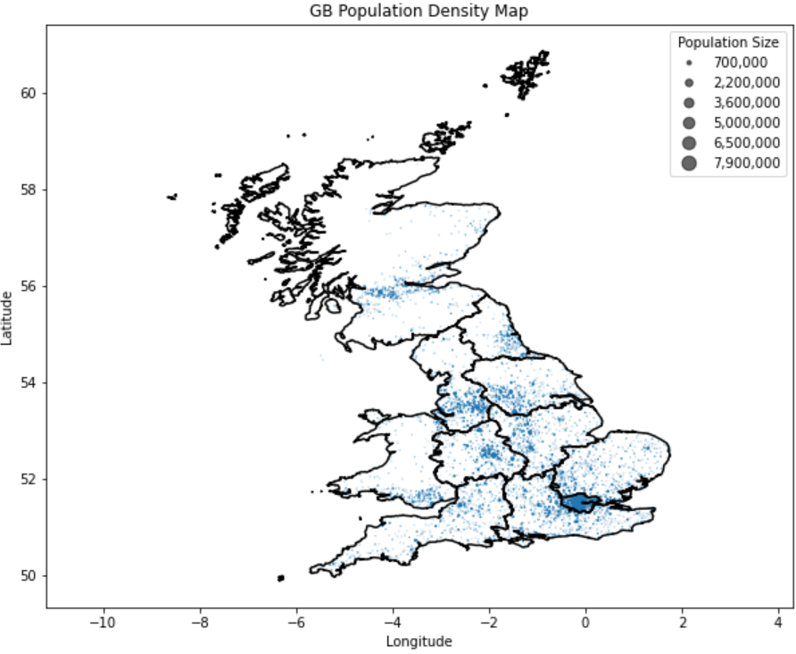
Model output vision: diagram of optimal cracking (decentralized vs centralized) in import country
Plan on using population as a proxy for demand (quantity and location)
Can decrease # of cities for model runtime
Will be creating supply chain links from certain import terminals based on varying objectives (min costs, equity considerations, etc..)
*Every city in GB (more than 1k) scaled by population

Slide 12
Next Steps
Clarify transport structure aligns with the goal of the project (creating a complete value chain from cradle to consumption)
Initiate formulation and validation of basic model
Rework any data issues for production model
Right now, no clear impetus for developing user interface side of model

Slide 13
Questions that can be explored with downstream model
How does the dynamic demand profile of an import country impact overall DLCOA (and thus optimal partners)
Most novel aspect of work
Countries to explore: UK, Germany, Japan
How does incorporating equity/security considerations change the DLCOA
E.g. must create connections for all cities over 10,000 people
How do optimal port locations differ (and thus network structure) versus modern terminal/gas structures
Can have two runs: 1. import terminals provided, 2. import terminal locations optimized

Slide 14
Model requirement #1: Decide the structure of the supply chain
Inputs
Import terminals/region of import
Demand locations
Outputs
Optimal Import Locations
Cracking locations
Pipeline/truck routes
Model dimensions
Will follow similar details of the green ammonia model providing a detailed yet still black box overview

Slide 15
Model requirement #2: Decide the daily operation of the supply chain
Inputs
Daily production of Ammonia
Daily demand of Ammonia at each location
Can create multiple different scenarios for demand to explore sensitivity
Outputs
Scheduling of shipments
Scheduling of flows

